Slide 1
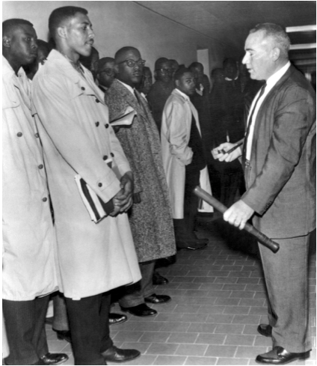
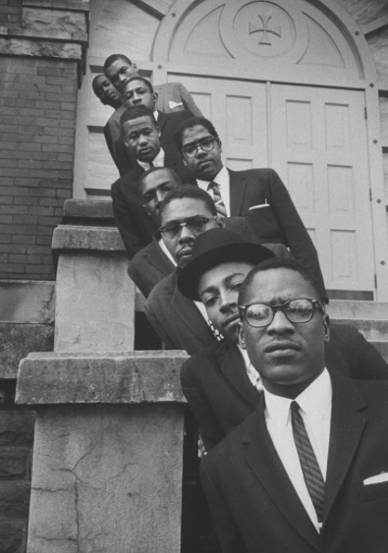
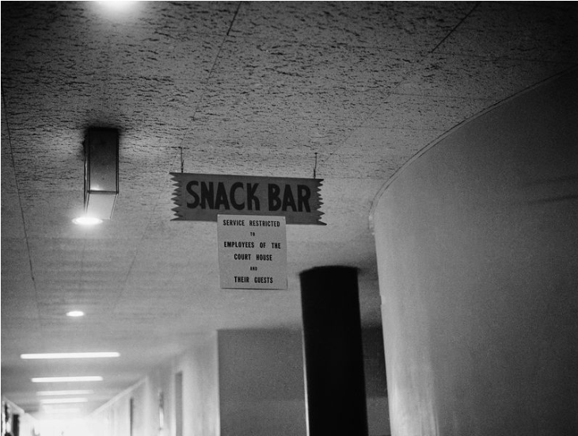
Montgomery 1960: St. John Dixon Spotlight
Amanda Ellis
Research Question: We sought to make Montgomery 1960 an engaging experience both through the gaming mechanics, while providing an accurate historical experience. Our mission in creating this was to create a game that encourages empathy and perspective taking, in order to create a new generation of change makers.
Methodology: The historical research was conducted through means of analyzing primary sources, such as newspapers and court documents, and listening to and conducting audio interviews. By analyzing these sources, the historical team was able to create a list of themes present throughout the events. The themes identified were matched with events from each of the student activists’ personal experience, which we called ‘gems’. These themes and gems
St. John Dixon Spotlight:
From Jackson, Alabama, noticed the disparities in how whites and blacks were treated in the South from a young age
Born to a poor family, the first in his family to go to college
Before college, took part in a demonstration to get his high school a cafeteria
One of 29 at sit-in, one of 9 expelled
Served as an unofficial spokesperson of the movement, using his outgoing personality
The other activists praised his dedication and ‘you can send me attitude’
Some Reoccurring Themes:
The Activist’s Recognitions of the Initial Threat of Racism
The Environment of Montgomery in 1960
The Activist’s First Act of Activism
Commitment/Engagement to the Movement
“The Price of Justice” – “Right has a cost”
The Mass Meetings and Trainings, with MIA Involvement

Slide 2
Citations
Dixon v. Alabama, 186 F. Supp 945 (Montgomery, Alabama 1960)
Dixon, St. John. “Dixon 5.13.13 Part 1.”By Dr. Karen Boyd. https://www.csctw.org/, 2013.
Dixon, St. John. “Dixon 5.13.13 Part 3.” By Dr. Karen Boyd. https://www.csctw.org/, 2013.
Dixon, St. John. “Dixon 5.13.13 Part 4.” By Dr. Karen Boyd. https://www.csctw.org/, 2013.
Dixon, St. John. “ASCA Opening 2010.” By Fred Gray. https://www.csctw.org/, 2010.
Dixon, St. John. “ASCA Students with Fred Gray.” By Fred Gray. https://www.csctw.org/, 2010.
Dixon, St. John. “Dixon 2020 Interview” By Dr. Karen Boyd and Amanda Ellis. https://www.csctw.org/, 2020.
McFadden, James. “McFadden Tuesday Afternoon.” By Amanda Ellis and Spencer Wood. https://www.csctw.org/, 2020.

